Slide 1
Sprint Review: Salesforce BAU
Sprint 13
16 June – 14 July

Slide 2




Sprint Overview
Sprint Numbers
Sprint Links
Key Dates
Weeks
4
Sprint work Items Delivered
Enhancement Testing
14 July – 18 July
Work Items Delivered
23
Payment Apportionment Testing
14 July – 25 July
UAT Items Addressed
0
Story Points Completed
22
BAU Go Live
21st July
Payment Apportionment Go Live
4th August

Slide 3
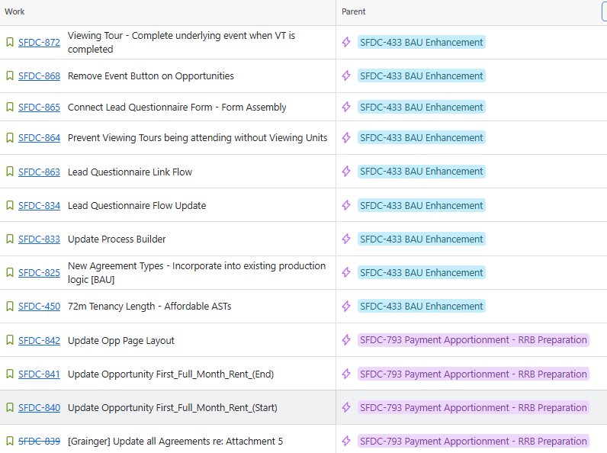
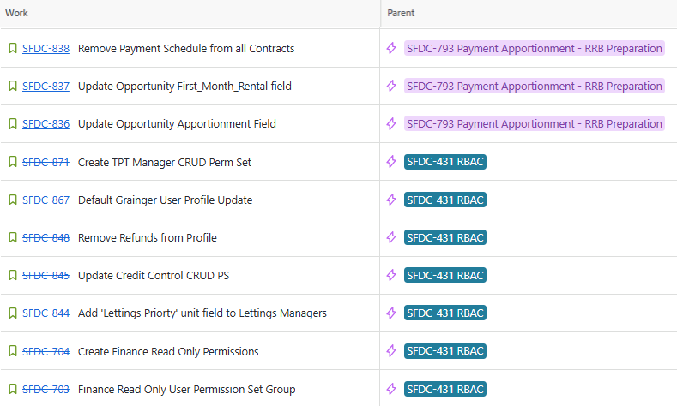
Work Items Delivered

Slide 4
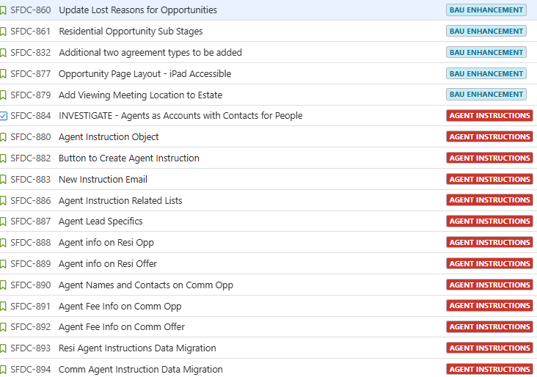
Work Items Planned for Next Sprint

Slide 5
General Items
Items Carried over to next Sprint | Reasons
Create GREP Integration Permission Sets and Permission Set Group Create Own Backup Permission Set/PSG | RBAC Items of lower priority
Risk | Contributing factors | Impact | Decisions taken
None
Issue | Contributing factors | Impact | Decisions taken
reCAPTCHA on Form Assembly forms impacting form performance |  | Alters how the form can be submitted, with conditional formatting and date inputs not displaying correctly | Hold off on release of SFDC-834. SFDC-863, and SFDC-865
Decision | Description | Date
Delay Payment Apportionment Release | Due to high impact nature of this change, as well as allowing time for TPT to adequately plan cut-over and align with workstreams, the date for the Payment Apportionment items will be pushed back to 4th August | 16th July 2025 – Jacob Smycz, Anita Masters, Clair Habgood

Slide 6

Thank You

